Slide 1
The Home Surge in MLB Alan M. Nathan, @pobguy University of Illinois

Slide 2
Outline
The issue
The committee
The 2015-2017 study
baseball.physics.Illinois.edu/HRReport2018.pdf
The 2016-2019 study
baseball.physics.Illinois.edu/HRReport2018.pdf
Summary & Open Questions

Slide 3
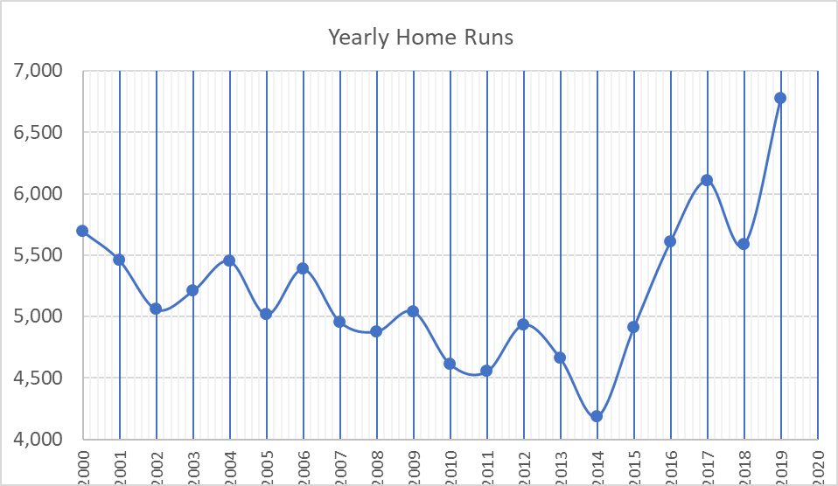
The Issue: Why HR Increase?
MLB Home Runs, 2000-2019
Phase 1: 2015-2017
Phase 2: 2016-2019
3

Slide 4
The Committee, Phase 1
Phase 2
MLB Liaisons:
Morgan Sword, Reed MacPhail, Roy Krasik

Slide 5
Other Independent Investigators
Rob Arthur, @No_Little_Plans
Drag coefficients from pitch analysis
Meredith Wills, @Bbl_Astrophysics
Ball dissection & changes
Bart Smith, @NotRealCertain
Baseball aerodynamics

Slide 6
Ground Rules
MLB provides whatever resources we requested
Full access to Statcast data
Baseball for laboratory testing
Test data from Rawlings
Visit to baseball manufacturing facility
…
We set our own agenda, arrived at our own conclusions, and wrote our report
baseball.physics.illinois.edu/homeruns.html

Slide 7
Visiting the facility
Turrialba

Slide 8
Possible Reasons For Surge
Change in launch conditions
Higher exit velocity
Ball “juiced”→elevated COR (“bounciness”)
Batters swinging harder
More optimum launch angle
“launch angle revolution”
Ball carries farther: reduced air drag
Property of ball: reduced “C_{D}”
Change in atmospheric conditions

Slide 9
Tools at our Disposal
Statcast statistical analysis
Distributions of EV, LA, …
Statcast trajectory analysis
Drag from pitched & batted balls
Fly ball distances
Laboratory measurements @ WSU (Lloyd Smith)
COR
Drag
Seam height
…
Physics
Putting it all together

Slide 10
Findings from 2015-2017
Change in launch conditions
Higher exit velocity
Ball “juiced”→elevated COR
Batters swinging harder
More optimum launch angle
“launch angle revolution”
Ball carries farther
Reduced air drag

Slide 11
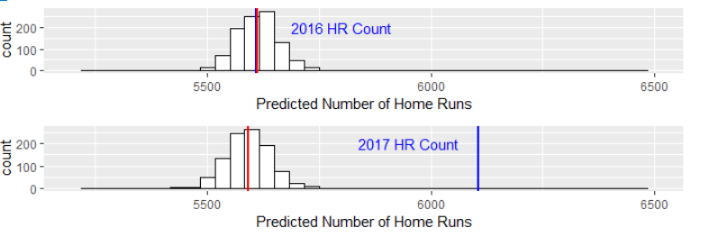
Example: 2016-2017
Model pHR(EV,LA) from 2016 data
Apply model to EV,LA of 2017 data
Predict HR for 2017
Result:
Predicted 2017 ≅ 2016 HR
Actual 2017 HR > 2016 HR
Conclude: excess 2017 HR due entirely to better carry
Supported by laboratory measurements

Slide 12
Supporting Evidence:
Measure ΔC_{D} in laboratory
Measure ΔC_{D} from Statcast trajectory analysis
Use physics-based model to estimate ΔC_{D} that accounts for HR increase
All is consistent!

Slide 13
As of 2018 report….
Reduced drag accounts for increase in HR
We had no explanation for either
large ball-to-ball variation
small year-to-year shift that explains HR
Led to improved instrumentation for laboratory measurements at WSU
Drag
Seam height
…

Slide 14
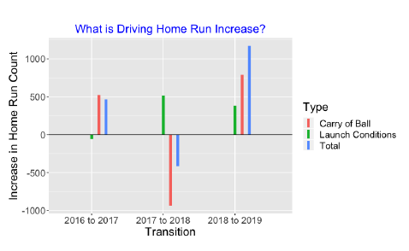
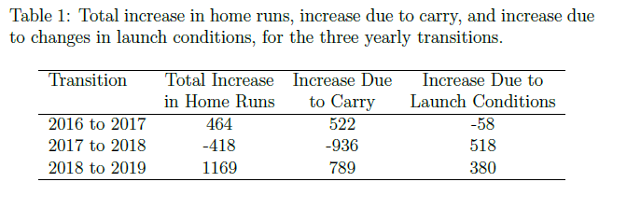
Findings from 2016-2019

Slide 15
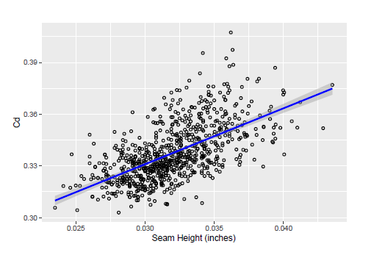
Ex: 2018-2019 Change
60% due to change in drag
Partly due to small change in seam height
Remainder unknown
40% due to change in launch parameters
Likely due to changes in batter behavior, not to changes in the ball

Slide 16
Summary/Open Questions
Home run changes due primarily to changes in aerodynamic properties of the baseball
Variation in seam height accounts for some of the changes…but not all
No evidence that variation is intentional
Drag is subtle and we still have a lot to learn!

