Slide 1
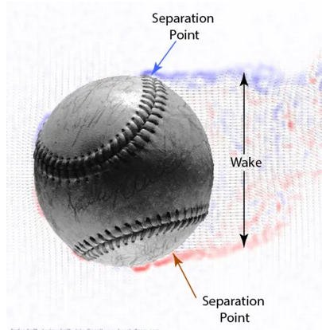
What Is Hawkeye Teaching Us About Baseball Pitches
Alan M. Nathan, @pobguy
Dept of Physics, University of Illinois
Image from Bart Smith
Notes:
Slide 1

Slide 2
Confluence of Two Evolutions
Evolution in Science
Evolution in Technology
Are these really Revolutions?
Have these developments changed the way we think about “pitch design”?

Slide 3
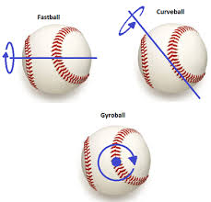
I. Evolution in Science
Pre-2020: Movement on a pitch is due to spin: Magnus
Active Spin: perpendicular to velocity
Movement in direction front of ball turns
Gyro Spin: parallel to velocity
No movement
Spin Efficiency = AS/TS

Slide 4
I. Evolution in Science
Pre-2020: Movement on a pitch is due only to spin
Magnus
2020: Bart Smith’s laboratory experiments show seams can cause movement
“Seam-Shifted Wake” (SSW)
Question:
Are there clearly identifiable SSH effects with MLB pitches?

Slide 5
II. Evolution in Technology
PITCHf/x & Trackman (2006-2019)
Trajectory ⇒ Movement measured
Spin axis (2D) inferred
Magnus assumed
No ability to …
detect SSH
measure spin efficiency
Notes:
Assuming movement all Magnus

Slide 6
II. Evolution in Technology
Hawkeye (2020- )
Trajectory + spin axis in 3D measured
Direction of Magnus movement determined
Direction of actual movement measured
If different, evidence for non-Magnus (SSH)
For the first time, we can investigate…
non-Magnus movement (SSH)
spin efficiency
How to do this is described in recent articles

Slide 7
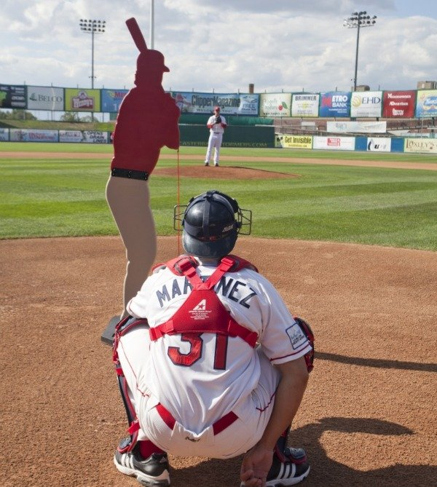
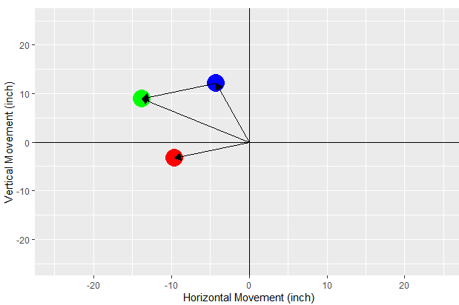
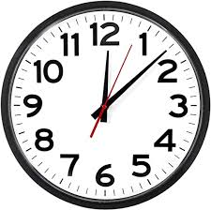
Movement, Catcher’s View
Green = total
Blue = Magnus
Red = SSW

Slide 8
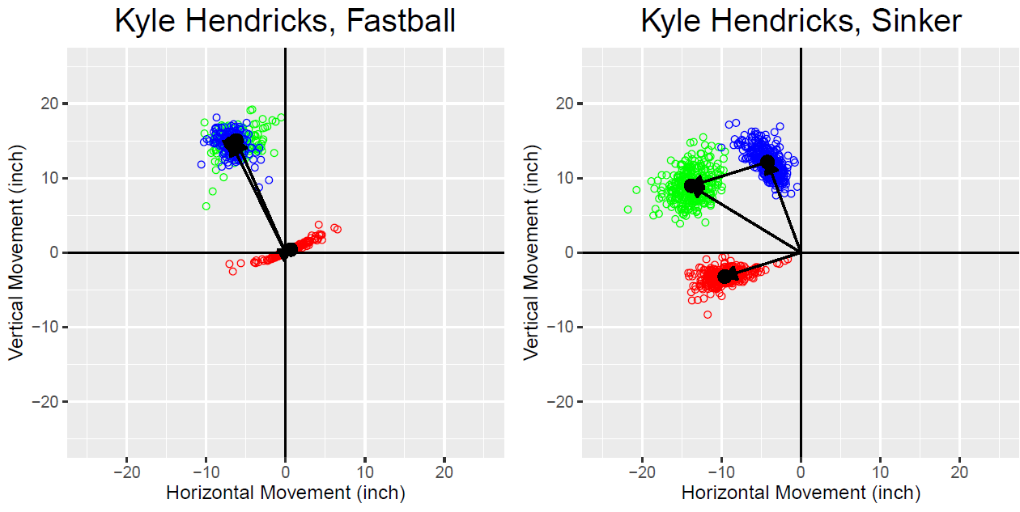
A Very Typical Example
4S
2S
Green = total
Blue = Magnus
Red = SSW
4S,2S spin axes nearly identical (within ~6⁰)
But movement directions very different
2S: large (38⁰) shift arm-side
4S: much smaller (~3⁰) shift glove-side
Clearcut evidence for SSH

Slide 9
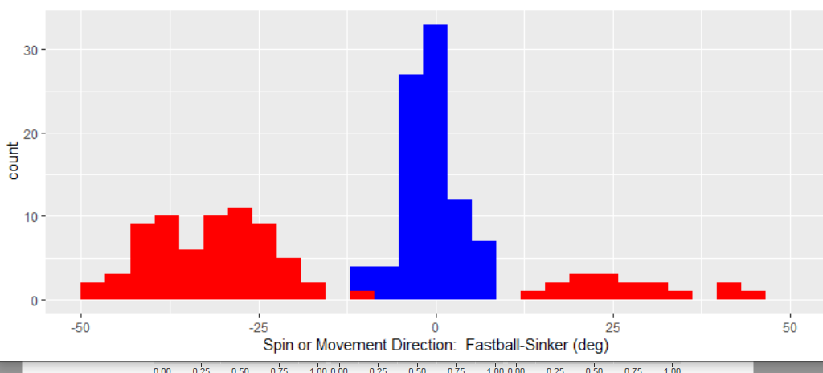
Spin Axis: 4S vs 2S
Spin Axis
difference
Movement Direction
difference
4S,2S have nearly same spin axis
determined by arm slot
But they have very different movements
due to SSW
TM & FX (and I) got it wrong!

Slide 10
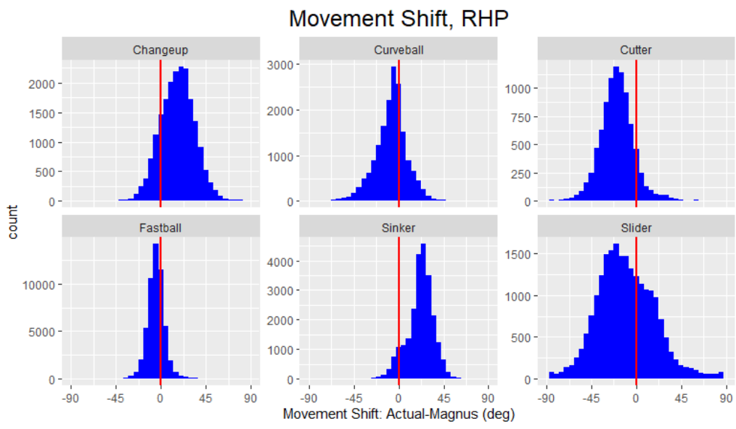
General Properties of SSH
glove-side
arm-side
SSH widespread!
Sinkers (2S) & fastballs (4S) behave differently
Both size and direction of shift
Consistent with Smith’s model for SSH

Slide 11
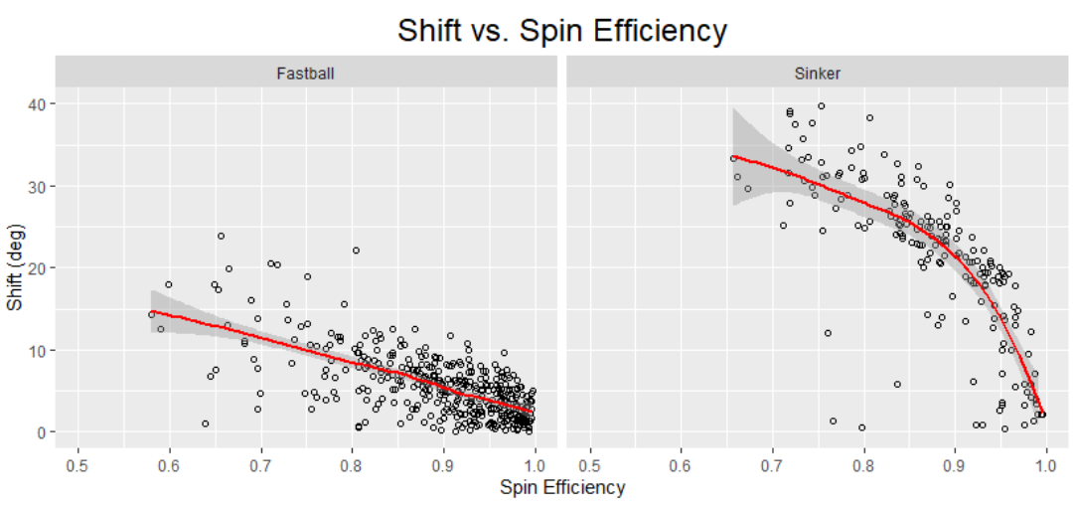
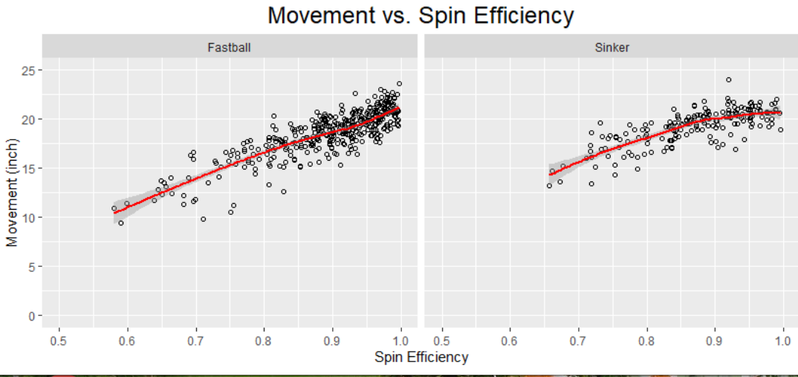
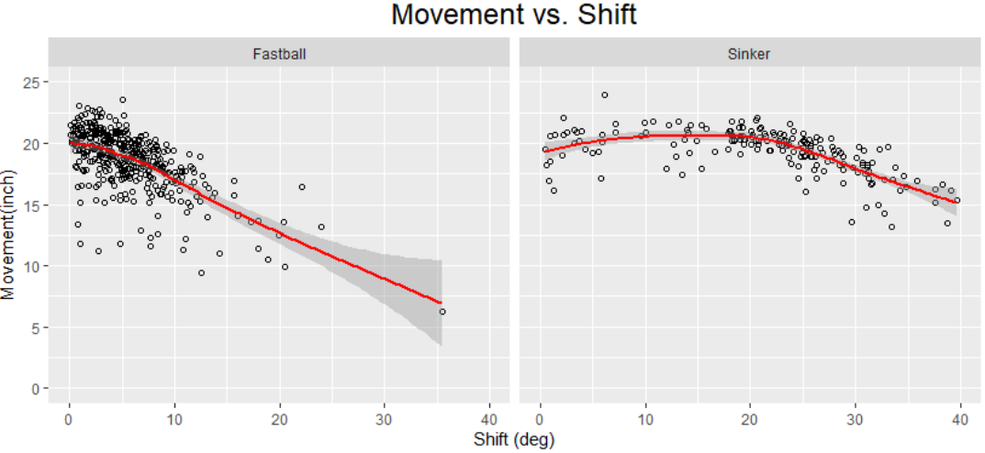
4S vs 2S
4S
2S
4S
2S
Magnus ↓ as eff ↓ (as it must)
SSH ↑ as eff ↓ (more rapidly for 2S)
Net: Movement ↓ as eff ↓ (less rapidly for 2S)
2S: Big shift w/o loss of movement

Slide 12
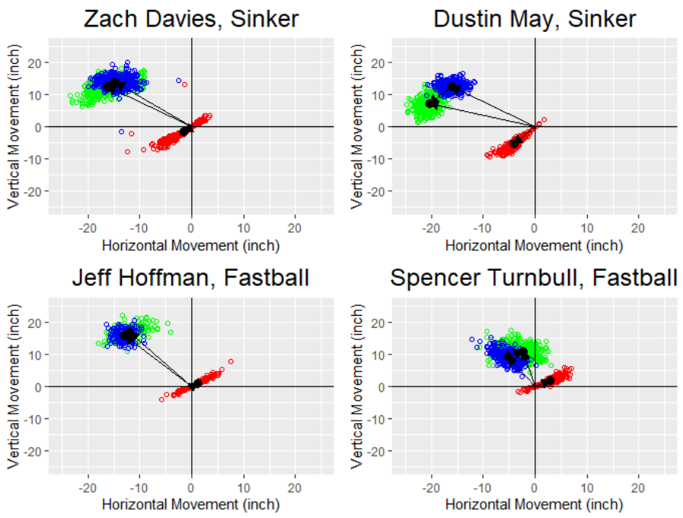
Example: 2S (Sinkers)
Eff=0.98
M=21”
Δ=6⁰
Eff=0.92
M=22”
Δ=18⁰
Small reduction in spin efficiency results in large shift in movement direction and no loss of movement
Eff=0.99
M=21”
Δ=4⁰
Eff=0.60
M=11”
Δ=18⁰
Notes:
ZD,DM SI has slightly lower eff, much larger shift, same total movement
ZD, JH similar eff, movement, small shift on 4S
DM and ST: To get same shift on 4S requires much lower eff and total movement

Slide 13
Example: 4S (Fastballs)
Large change in spin efficiency needed to get large shift in movement direction, with considerable loss of movement
Eff=0.98
M=21”
Δ=6⁰
Eff=0.92
M=22”
Δ=18⁰
Eff=0.99
M=21”
Δ=4⁰
Eff=0.60
M=11”
Δ=18⁰
Notes:
ZD,DM SI has slightly lower eff, much larger shift, same total movement
ZD, JH similar eff, movement, small shift on 4S
DM and ST: To get same shift on 4S requires much lower eff and total movement

Slide 14
Example: 4S-vs-2S
Large reduction in spin efficiency for 4S needed to get same shift in movement direction as 2S, with factor of two reduction in movement
Eff=0.98
M=21”
Δ=6⁰
Eff=0.92
M=22”
Δ=18⁰
Eff=0.99
M=21”
Δ=4⁰
Eff=0.60
M=11”
Δ=18⁰
Notes:
ZD,DM SI has slightly lower eff, much larger shift, same total movement
ZD, JH similar eff, movement, small shift on 4S
DM and ST: To get same shift on 4S requires much lower eff and total movement

Slide 15
Kyle Hendrick’s Two Changeups 4S and 2S

Slide 16
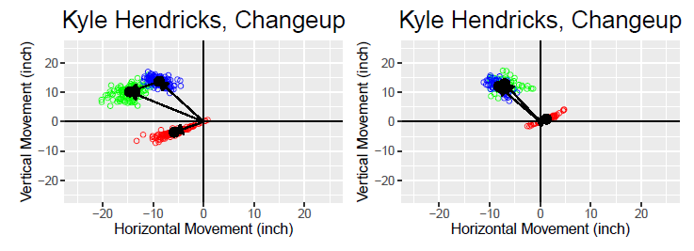
Kyle Hendricks’s Two Changeups
2S
4S
Identical spin axes & efficiency but….
2S shifted armside; 4S slight shift gloveside
2S looks like sinker; 4S looks like fastball
Can this be used for pitch ID?
Could verify w/Hawkeye seam orientation
Notes:
No evidence for cut….just less armside

Slide 17
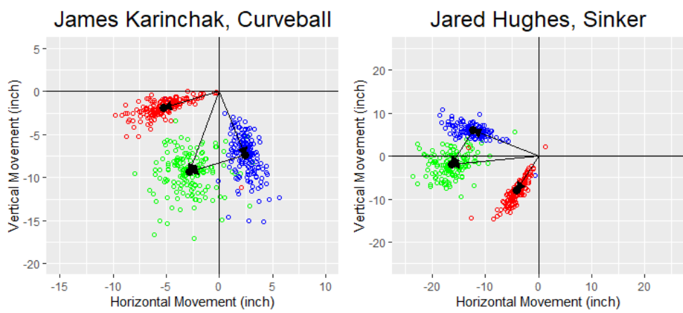
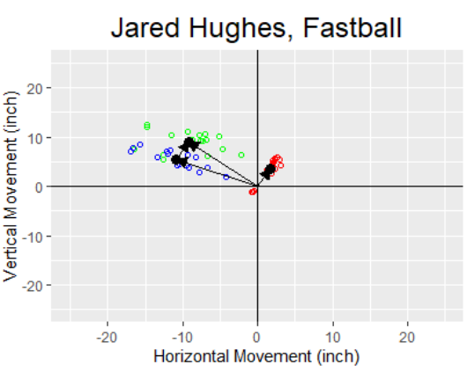
Karinchak Curveball: Gloveside-to-armside
Hughes Sinker: It really sinks!
Hughes Fastball: It “rises”
Notes:
RHP

Slide 18
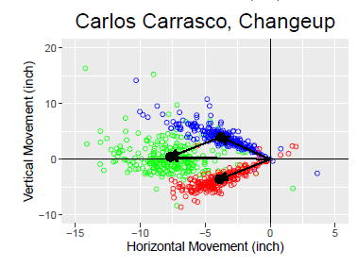
Carlos Carrasco’s Changeup

Slide 19
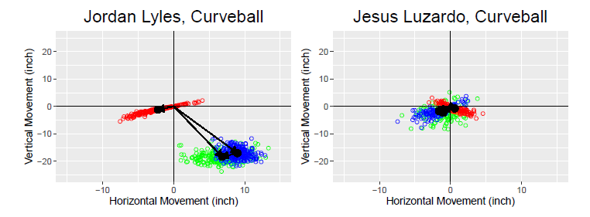
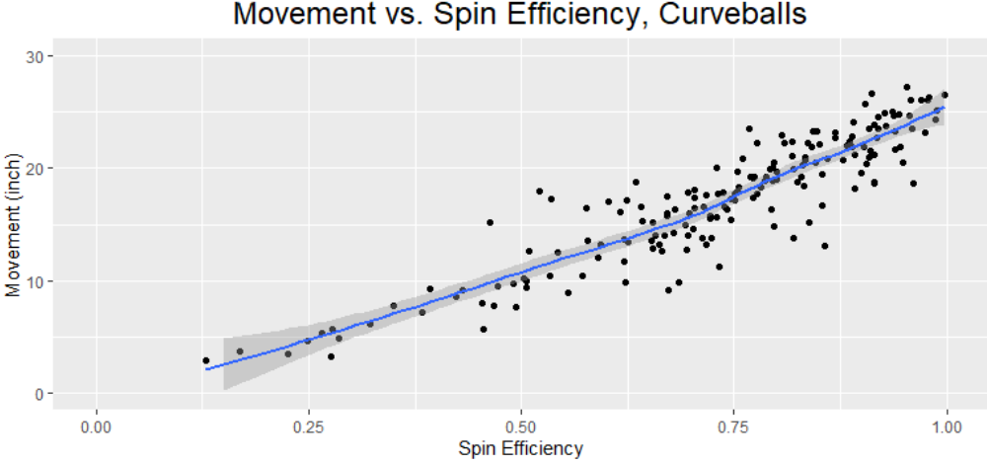
Spin Efficiency & Movement: Curveballs
2500 rpm, eff=0.80
2500 rpm, eff=0.23

Slide 20
Drag and Spin
Drag slows the ball
Small effect on pitches (~10%)
But a good way to monitor Cd (Rob Arthur)
Relevance for “has the ball changed?”
BIG effect on fly balls: Home Runs!
Drag depends on spin
Total spin? Transverse (active) spin only? Gyro spin?
Does seam orientation affect drag?????

Slide 21
Drag and Spin
-Cd depends…
strongly on active spin
weakly on gyro spin
-Need to control for spin in drag analysis
C_{D} vs. gyrospin
for active spin=2000 rpm
C_{D} vs active spin
for gyrospin=2000 rpm

Slide 22
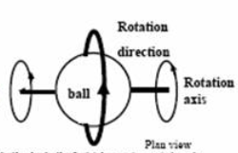
Spin Efficiency Varies
pure gyro at release
gyro+side at plate
As ball falls…
Gyro→ Sidespin: Eff ↑
slider, cutter
Sidespin → Gyro: Eff ↓
changeup, sinker
Back/Topspin stays same: Eff ↔
fastball, curveball

Slide 23
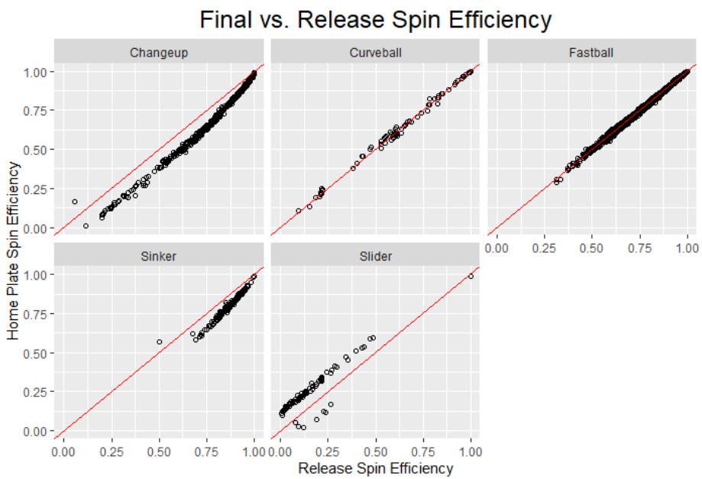
side
top
back
side
gyro
Effect on movement?
Magnus: very little
SSW: ???

Slide 24
The Future…
Batted Balls:
knuckleballs: the ultimate SSW effect
backspin, sidespin, gyrospin
spin decay and/or axis precession
spin-dependent drag
Goal: develop improved trajectory model

Slide 25
Thanks to…
Bart Smith
For educating us
…and some great fishing expeditions!
Glenn Healey
For many illuminating discussions
MLB & Baseball Prospectus
For sharing the data & great discussions
Clay Nunnally, Tom Tango, Harry Pavlidis

Slide 26
And finally….
Robert K. Adair
1924-2020

